Slide 1

DESIGN AND ANALYSIS OF ALGORITHMS
Dr. Kashif Ayyub

Slide 2

Computational Problems
A problem that can be solved step-by-step with a computer. These problems usually have a well-defined input, constraints, and conditions that the output must satisfied.

Slide 3
Specify a Computational Problem?
A computational problem is specified by one (or more) pairs of preconditions and postconditions.
Precondition: A condition that one might expect to be satisfied when the execution of a program begins. This generally involves the algorithm’s inputs as well as initial values of global variables.
Postcondition: A condition that one might want to be satisfied when the execution of a program ends. This might be
A set of relationships between the values of inputs (and the values of global variables when execution started) and the values of outputs (and the values of global variables on a program’s termination), or
A description of output generated, or
Exception(s) raised.

Slide 4
Example: Specification of a “Search” Problem
Precondition P1: Inputs include
n: a positive integer
A: an integer array of length n, with entries
A[0], A[1], . . . , A[n-1]
key: An integer found in the array (ie, such that A[i] = key for at least one integer i between 0 and n-1)
Postcondition Q1:
Output is the integer i such that 0 ≤ i < n, A[j] ≠ key for every integer j such that 0 ≤ j < i, and such that A[i] = key
Inputs (and other variables) have not changed
This describes what should happen for a “successful search.”

Slide 5
Example: Specification of a “Search” Problem
Precondition P2: Inputs include
n: a positive integer
A: an integer array of length n, with entries
A[0], A[1], . . . , A[n-1]
key: An integer not found in the array (ie, such that A[i] ≠ key for integer i between 0 and n-1)
Postcondition Q2:
A notFoundException is thrown
Inputs (and other variables) have not changed
This describes what should happen for an “unsuccessful search.”

Slide 6
Example: Finding the maximum
Given a finite list L of k integers (k > 0), find the integer with the maximum value from the list.
First, let's consider if this is a computational problem. The input is very well defined. We know what an integer is. We are told we have at least one, and we have a finite number of them.
Second, let's consider the output. What conditions must the output satisfy? First, it has to be equal or larger than every other integer on the list. Second, it must be an integer in the list. This is well defined by the problem statement, so we can say that it is a computational problem.
Here is an example. Suppose the input consists of:
4 1 -4 0 9 9 3 5 8
The output should be 9.

Slide 7
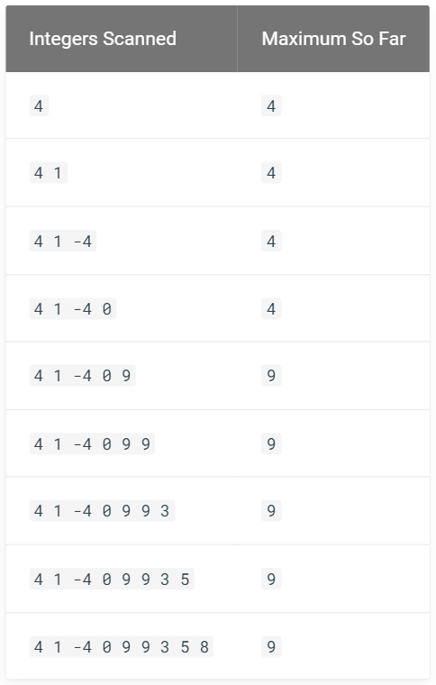
Example: Finding the maximum
One way to solve this problem is to check through the integers in the list, one-by-one, and keep track of the maximum value so far. When you reach the end of the list, your "maximum value so far" will also be the maximum for the whole list.
Let's look at an example:
The English description above, however, is not detailed enough for computers to understand. What is the meaning of "check one-by-one"? "keep track of maximum so far"? how to tell if we have reached "the end of the list"?

Slide 8
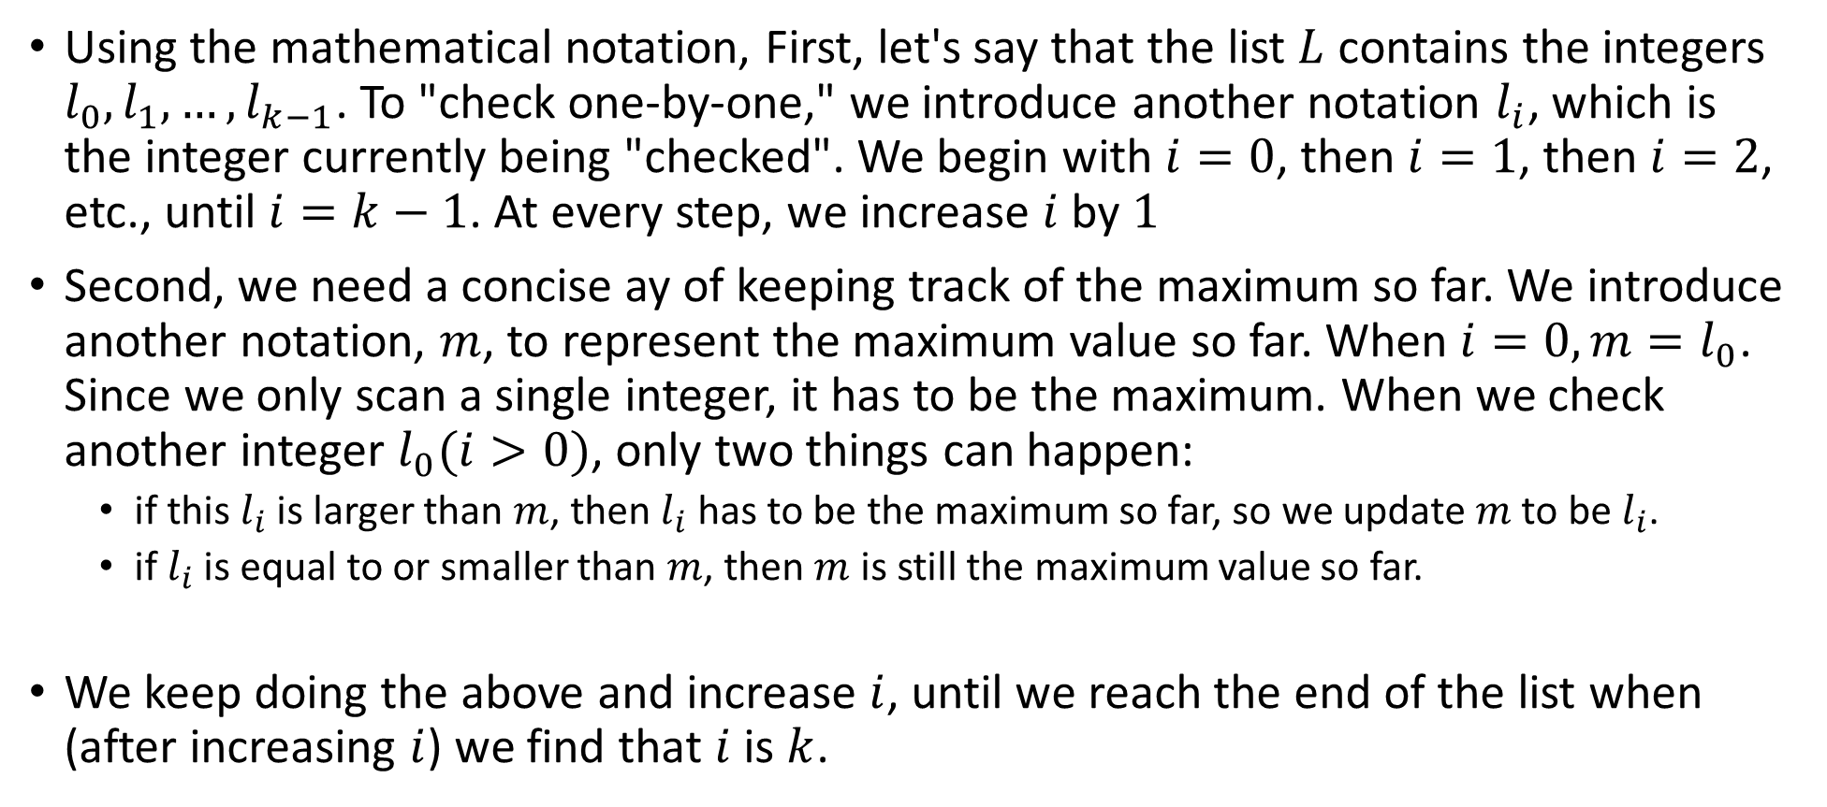
Example: Finding the maximum
Using the mathematical notation, First, let's say that the list $L$ contains the integers $l_{0},l_{1},…,l_{k−1}$. To "check one-by-one," we introduce another notation $l_{i}$, which is the integer currently being "checked". We begin with $i=0$, then $i=1$, then $i=2$, etc., until $i=k−1$. At every step, we increase $i$ by $1$
Second, we need a concise ay of keeping track of the maximum so far. We introduce another notation, $m$, to represent the maximum value so far. When $i=0, m=l_{0}$. Since we only scan a single integer, it has to be the maximum. When we check another integer $l_{0}(i>0)$, only two things can happen:
if this $l_{i}$ is larger than $m$, then $l_{i}$ has to be the maximum so far, so we update $m$ to be $l_{i}$.
if $l_{i}$ is equal to or smaller than $m$, then $m$ is still the maximum value so far.
We keep doing the above and increase $i$, until we reach the end of the list when (after increasing $i$) we find that $i$ is $k$.

Slide 9
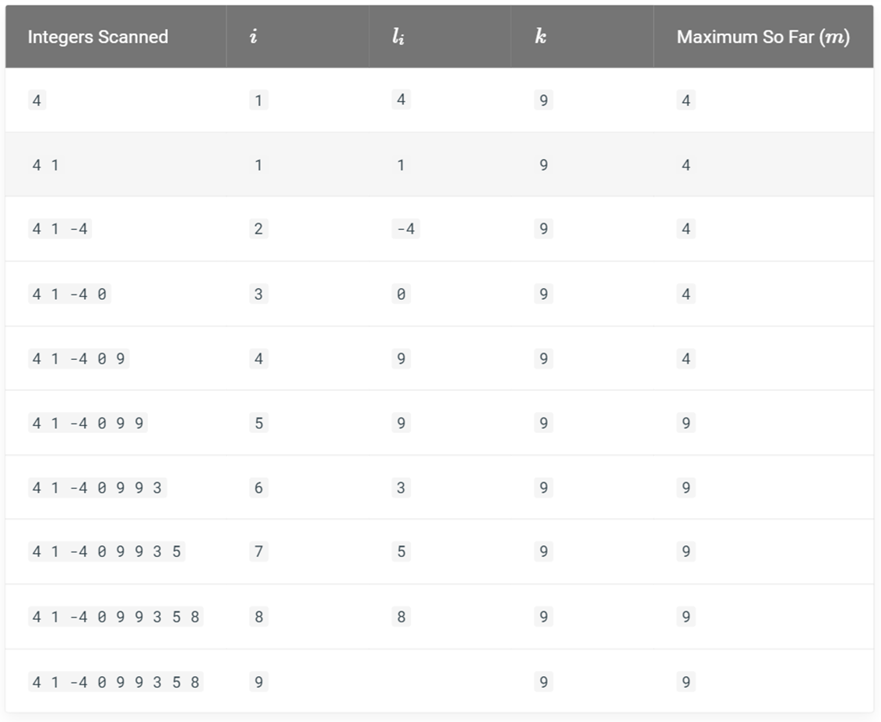
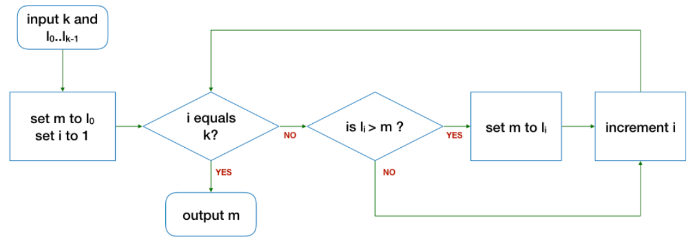

Example: Finding the maximum
$${L=l}_{0},l_{1},…,l_{k−1}$$

Slide 10
Correctness of an Algorithm
It is important for an algorithm to be correct.
A correct algorithm always produces the expected output or follows the ground truth for the range of valid inputs and, eventually, terminates.
There are two types of correctness:
Partial Correctness
Total Correctness
Correctness
Partial Correctness
Total Correctness

Slide 11
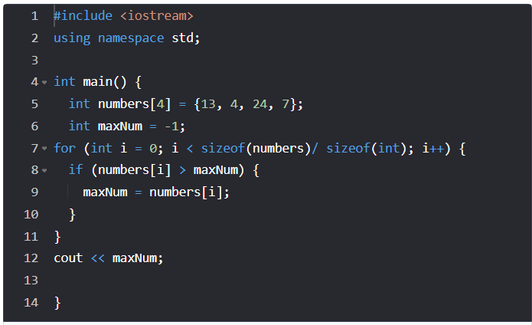
Partial Correctness
An algorithm is partially correct if it receives valid input and then terminates.
Test Case – 1: { 13, 4, 24, 7 }
Test Case – 2: { -13, -4, -24, -7 }

Slide 12
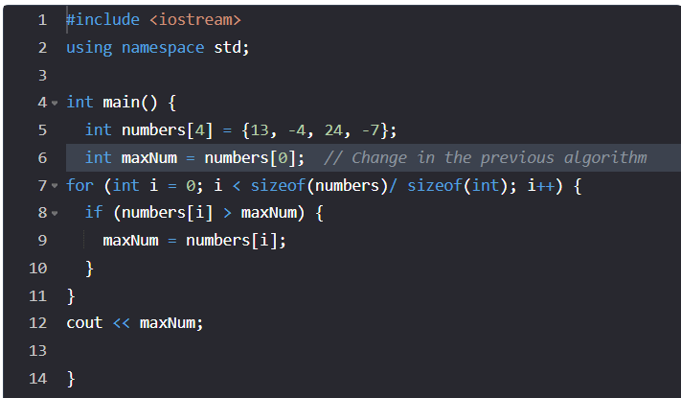
Total Correctness
An algorithm is totally correct if it receives valid input, terminates, and always returns the correct output.
Test Case – 1: { 13, -4, 24, -7 }
Test Case – 2: { 13, 4, 24, 7 }

